Slide 1








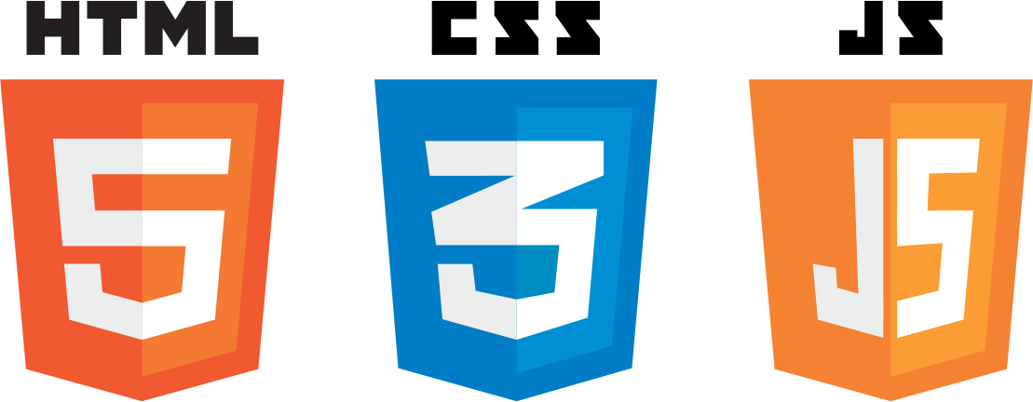
React Presentation

Slide 2
AGENDA
Reactjs
React Router
Flux

Slide 3
What is React?
React is a javascript library for building user interface (facebook)
React (sometimes styled React.js or ReactJS) is an open-source JavaScript library providing a view for data rendered as HTML. React views are typically rendered using components that contain additional components specified as custom HTML tags (Wikipedia).

Slide 4
Who Uses React.js?
Instagram.com is 100% built on React, both public site and internal tools.
Facebook.com‘s commenting interface, business management tools, Lookback video editor, page insights, and most, if not all, new JS development.
Khan Academy uses React for most new JS development.
Sberbank, Russia’s number one bank, is built with React.
The New York Times’s 2014 Red Carpet Project is built with React.
…

Slide 5
How To Use React Js?
helloworld.html
<script src="build/react.js"></script>
<script src="build/react-dom.js"></script> …
<body> <div id="example"></div></body>
<script type="text/javascript">
var HelloMessage = React.createClass({
displayName: "HelloMessage",
render: function render() {
return React.createElement( "div",null,"Hello ",this.props.name
);
}
});
ReactDOM.render(React.createElement(HelloMessage, { name: "John" }), mountNode);</script>

Slide 6
How To Use React Js?
helloworld.html
<script src="build/react.js"></script>
<script src="build/react-dom.js"></script>
<script src="https://cdnjs.cloudflare.com/ajax/libs/babel-core/5.8.23/browser.min.js"></script> …
<body> <div id="example"></div></body>
<script type="text/babel">
var HelloMessage = React.createClass({
render: function render() {
return <div>hello</div>);}
});
ReactDOM.render(
<HelloMessage /> ,document.getElementById('example')
);
</script>

Slide 7
How To Use React Js?
Node.js, npm for front-end development.
Collect dependency avaiable on npm.
Easy to install project by simply run npm install.
Allow to store and run script such as build,test,dev…
"scripts": {
"test": "echo \"Error: no test specified\" && exit 1",
"build": "browserify -t [ babelify --presets [ react ] ] src/index.js -o build/app.js"
},
“dependency”:{
“react”:”^0.14.0”,
“react-router”:”^0.12.1”
}
Notes:
Node js và npm là công cụ chính để download các thư viện js cũng như các dev tool để chạy trong quá trình phát triễn
C ũng như lưu trử và thực thi các đoạn scipt để build và dev
Chém về cài đạt node và npm

Slide 8
How To Use React Js?
What is Browserify?
<script src=“module_a.js"></script>
<script src=“module_b.js"></script>
<script src=“module_c.js"></script>…
Normally when we want to include some library code in our project, we include another script tag on the page
Managing the scripts and especially the correct order of scripts can become tedious, especially if we use a lot of small libraries as is popular with npm.
Notes:
Rắc rối ở chổ khi số lượng các module ngày càng nhìu càng khó quản lý

Slide 9
How To Use React Js?
What is Browserify?
Browserify helps us solve this by letting us use CommonJS style require('filename') in our code. All of the required files are bundled together into a single file which we can then include on our page.
Using require also makes it easier to tell which functionality our code is using, and it avoids relying on everything being available globally.
browserify -t [ babelify --presets [ react ] ] src/index.js -o build/app.js
<!DOCTYPE html>
<html>
<head> </head>
<body> <div id="app"></div>
<script src="build/app.js"></script>
</body>
</html>
var React =require('react');
module.exports = React.createClass({
render: function() {
return <p>{this.props.message}</p>;
} });
Notes:
Sử dụng browserify để chia nhỏ source code thành nhiều file js và để trong những thư mục khác nhau
Sử dụng require không ảnh hưởng đén các biên global scop mà chỉ có tác cụng trong module

Slide 10
How To Use React Js?
Grunt,Grulp with Browserify
Gulp is a JS build system, like Grunt, that makes use of “streams”, or pipelining, and focuses on code-over-configuration. Build systems are usually set up to watch for changes to projects, and then automatically handling common build steps such as bundling, pre-compilation, or minification. Both Gulp and Grunt have tons of plugins to help with these things. Browserify is one such plugin.
/* gulpfile.js */ var gulp = require('gulp'); var browserify = require('browserify'); // Bundles JS. gulp.task('js', ['clean'], function() { // Browserify/bundle the JS. browserify(paths.app_js) .transform(reactify) .bundle() .pipe(source('bundle.js')) .pipe(gulp.dest('./src/')); }); gulp.task('watch', function() { gulp.watch(paths.css, ['css']); gulp.watch(paths.js, ['js']); });
Gulp run js Gulp run watch
https://github.com/vigetlabs/gulp-starter https://github.com/jakemmarsh/react-rocket-boilerplate
Notes:
Grun và gulp là task runner để build và chạy các một số task cùng một lúc bằng ngôn ngữ javascript ,
Vidu: gọi task
Cài đặt grun và grup thông qua npm
Có thể cài global để chạy trực tiếp không thông qua npm

Slide 11
How To Use React Js?
Webpack
Webpack will traverse through the require statements of your project and will generate the bundles you have defined. You can even load your dependencies in a dynamic manner using a custom require.ensure statement. The loader mechanism works for CSS as well and @import is supported. There are also plugins for specific tasks, such as minification, localization, hot loading, and so on.
webpack
var webpack = require('webpack'); module.exports = {
entry: './entry.js',
output: {
path: __dirname,
filename: 'bundle.js‘
},
module: {
loaders: [ { test: /\.css$/, loaders: ['style', 'css'] } ] }, plugins: [ new webpack.optimize.UglifyJsPlugin() ] };
Notes:
Webpack là tool mới được phát triển và được sử dụng rất phổ biến với nhiều tinsnh năng vược trội hơn
Weback chuyên dụng cho compile budle modules
Chỉ cần một vài config đơn giảng sau đó chạy lệnh webpack

Slide 12
How To Use React Js?
Babel Compiler.
Babel transforms your JavaScript
You put JavaScript in
And get JavaScript out
[1,2,3].map(n => n + 1);
es2015
{1,2,3].map(function(n) { return n + 1; });
var app = <Nav color="blue" />;
jsx(react)
var app = React.createElement(Nav, {color:"blue"});
npm install --save-dev babel-preset-react
Notes:
Babel là một compiler dùng để convert các ngôn ngữ script mới (es6,coffe script, type script, …) thành javascript thuần để code có thể chạy trên tất cả các browser
Babel sẻ được truyền trực tiếp, hoặc thông qua .babelirc file vào broserify hay webpack để sử dụng trong quá trình bundle script

Slide 13
How To Use React Js?
React And Jsx
JSX is a JavaScript syntax extension that looks similar to XML. You can use a simple JSX syntactic transform with React.
React JSX transforms from an XML-like syntax into native JavaScript. XML elements, attributes and children are transformed into arguments that are passed to React.createElement.
var App = ( <Form>
<FormRow>
<FormLabel />
<FormInput /> </FormRow>
</Form> );
var App = (
React.createElement(Form, null, React.createElement(Form.Row, null, React.createElement(Form.Label, null), React.createElement(Form.Input, null) ) ) );
Notes:
Jsx là bộ cú pháp có cấu trúc tương tự như xml sẻ được biên dịch về javascript thuần

Slide 14
How To Use React Js?
React And Jsx
HTML Tags (lower-case tag names in JSX:)
var myDivElement = <div className="foo" />; ReactDOM.render(myDivElement, document.getElementById('example'));
React Components( upper-case letter:)
var MyComponent = React.createClass({/*...*/});
var myElement = <MyComponent someProperty={true} />;
ReactDOM.render(myElement, document.getElementById('example'));
Notes:
Html tag và React Component được phân biệt dự vào ký tự đầu tiên của thẻ Jsx

Slide 15
How To Use React Js?
React And Jsx
JavaScript Expressions
To use a JavaScript expression as an attribute value, wrap the expression in a pair of curly braces ({}) instead of quotes ("").
/ Input (JSX): var person = <Person name={window.isLoggedIn ? window.name : ''} />; // Output (JS): var person = React.createElement( Person, {name: window.isLoggedIn ? window.name : ''} );
var content = <Container>{window.isLoggedIn ? <Nav /> : <Login />}</Container>;
// Output (JS): var content = React.createElement( Container, null, window.isLoggedIn ? React.createElement(Nav) : React.createElement(Login) );

Slide 16
How To Use React Js?
React And Jsx
JavaScript Expressions
return ( <section>
<h1>Color</h1>
<h3>Name</h3>
<p>{this.state.color || "white"}</p>
<h3>Hex</h3>
<p> {(() => {
switch (this.state.color) {
case "red": return "#FF0000";
case "green": return "#00FF00";
case "blue": return "#0000FF";
default: return "#FFFFFF"; } })()}
</p> </section>
);
Notes:
Để mã nguồn rỏ rang và thẩm mỹ hơn ta có thể tạo và chyaj hàm ngay trong jsx để sự dụng javascript tính toán và trả về những element

Slide 17
How To Use React Js?
React And Jsx
JavaScript Expressions
return ( <section>
<h1>Color</h1>
<h3>Name</h3>
<p>{this.state.color || "white"}</p>
<h3>Hex</h3>
<p> {(() => {
switch (this.state.color) {
case "red": return "#FF0000";
case "green": return "#00FF00";
case "blue": return "#0000FF";
default: return "#FFFFFF"; } })()}
</p> </section>
);
Notes:
Để mã nguồn rỏ rang và thẩm mỹ hơn ta có thể tạo và chyaj hàm ngay trong jsx để sự dụng javascript tính toán và trả về những element

Slide 18
How To Use React Js?
Basic Demo (https://facebook.github.io/react/index.html)
Notes:
Để mã nguồn rỏ rang và thẩm mỹ hơn ta có thể tạo và chyaj hàm ngay trong jsx để sự dụng javascript tính toán và trả về những element

Slide 19
REACT JS
Top API
React.Component: class Component (es6)
React.createClass: ReactClass createClass(object specification)
React.createElement: ReactElement createElement( string/ReactClass type, [object props], [children ...] )
….
ReactDOM.render: render( ReactElement element, DOMElement container, [function callback] )
ReactDOM.findDOMNode: DOMElement findDOMNode(ReactComponent component)
ReactDOMServer …

Slide 20
REACT JS
Components
<div>, <span>, <ActionButton>, <Counter>
Var MyComponent = React.createClass({
render: function(
return <span>Hello!</span>
);
});
React.render(<MyComponent />, document.getElementById('myDiv'));

Slide 21
REACT JS
Components
Instances of a React Component are created internally in React when rendering. These instances are reused in subsequent renders.
The only way to get a handle to a React Component instance outside of React is by storing the return value of ReactDOM.render
Inside other Components, you may use refs to achieve the same result.
setState(): This is the primary method you use to trigger UI updates from event handlers and server request callbacks.
replaceState():
…

Slide 22
REACT JS
Components
<div>, <span>, <ActionButton>, <Counter>
Var MyComponent = React.createClass({
render: function(
return <span>Hello!</span>
);
});
React.render(<MyComponent />, document.getElementById('myDiv'));

Slide 23
REACT JS
State and Props
What are props?
props are best explained as “a way of passing data from parent to child.”
In essence, props are just a communication channel between components, always moving from top (parent) to bottom (child).

Slide 24
REACT JS
State and Props
What are props?
Parent = React.createClass({
tacos: [ 'Guacamole', 'Beef', 'Bean' ],
render() { return <div className="parent-component"> <
h3>List of tacos:</h3>
<TacosList tacos={ this.tacos } /> </div>; } });
TacosList = React.createClass({ render() {
return <div className="tacos-list">
{
this.props.tacos.map(
( taco, index ) => { return <p key={ `taco-${ index }` }>{ taco }</p>;
})
} </div>;
} });

Slide 25
REACT JS
State and Props
What is state?
State is another concept introduced by React and behaves a little bit differently from props. State is best described as how a component’s data looks at a given point in time.
Using state, we can change how this data looks based on user input or interaction.

Slide 26
REACT JS
State and Props
What is state?
Parent = React.createClass({
getInitialState() {
return { tacos: [ 'Guacamole', 'Beef', 'Bean' ] };
},
handleReverse() {
this.setState( { tacos: this.state.tacos.reverse() } );
},
render() {
return <div className="parent-component">
<h3 onClick={ this.handleReverse }>List of tacos:</h3>
<TacosList tacos={ this.state.tacos } />
</div>;
} });

Slide 27
REACT JS
Components
When creating a component class by invoking React.createClass(), you should provide a specification object that contains a render method and can optionally contain other lifecycle methods described here.
Every component has a state object and a props object

Slide 28
REACT JS
Component Specs and Lifecycle
render(): return a single child element. You can also return null or false to indicate that you don't want anything rendered.
getInitialState,getDefaultProps
Mounting: componentWillMount, componentDidMount,
Updating: componentWillReceiveProps, shouldComponentUpdate, componentWillUpdate, componentDidUpdate
Unmounting: componentWillUnmount

Slide 29
Component Lifecycle
Components have three main parts of their lifecycle:
Mounting: A component is being inserted into the DOM.
Updating: A component is being re-rendered to determine if the DOM should be updated.
Unmounting: A component is being removed from the DOM.

Slide 30
REACT JS
Anatomy of a Component: Properties
<ActionButton text="Book flight“ onAction={someFunc} />
var ActionButton = React.createClass({
render: function() {
return(
<button className="ActionButton“ onClick={this.props.onAction}>
<span>>{this.props.text}</span>
</button>
);
}
});

Slide 31
REACT JS
Anatomy of a Component: State
<Counter initialCount={4}/>
var Counter = React.createClass({
getInitialState: function() {
return {count: this.props.initialCount};
},
addToCount: function(delta) {
this.setState({count: this.state.count + delta})
},
render: function() {
return (
<div> <h3>Count: {this.state.count}</h3>
<ActionButton text="+1" onAction={this.addToCount.bind(this, 1)} />
<ActionButton text="-1" onAction={this.addToCount.bind(this, -1)} />
</div>
);
}
});

Slide 32
REACT JS
var MyComponent = React.createClass({
render: function(){
return (
<h1>Hello, {this.props.name}!</h1>
);
}
});
ReactDOM.render(<MyComponent name="Handsome" />, document.getElementById('myDiv'));

Slide 33
Component Lifecycle - Mounting
getInitialState(): object is invoked before a component is mounted. Stateful components should implement this and return the initial state data.
componentWillMount(): is invoked immediately before mounting occurs.
componentDidMount(): is invoked immediately after mounting occurs. Initialization that requires DOM nodes should go here.

Slide 34
Component Lifecycle - Updating
componentWillReceiveProps(object nextProps): is invoked when a mounted component receives new props.
shouldComponentUpdate(object nextProps, object nextState(): boolean is invoked when a component decides whether any changes warrant an update to the DOM.
componentWillUpdate(object nextProps, object nextState): is invoked immediately before updating occurs. You cannot call this.setState() here
componentDidUpdate(object prevProps, object prevState): is invoked immediately after updating occurs.

Slide 35
Component Lifecycle - Unmounting
componentWillUnmount():is invoked immediately before a component is unmounted and destroyed. Cleanup should go here.

Slide 36
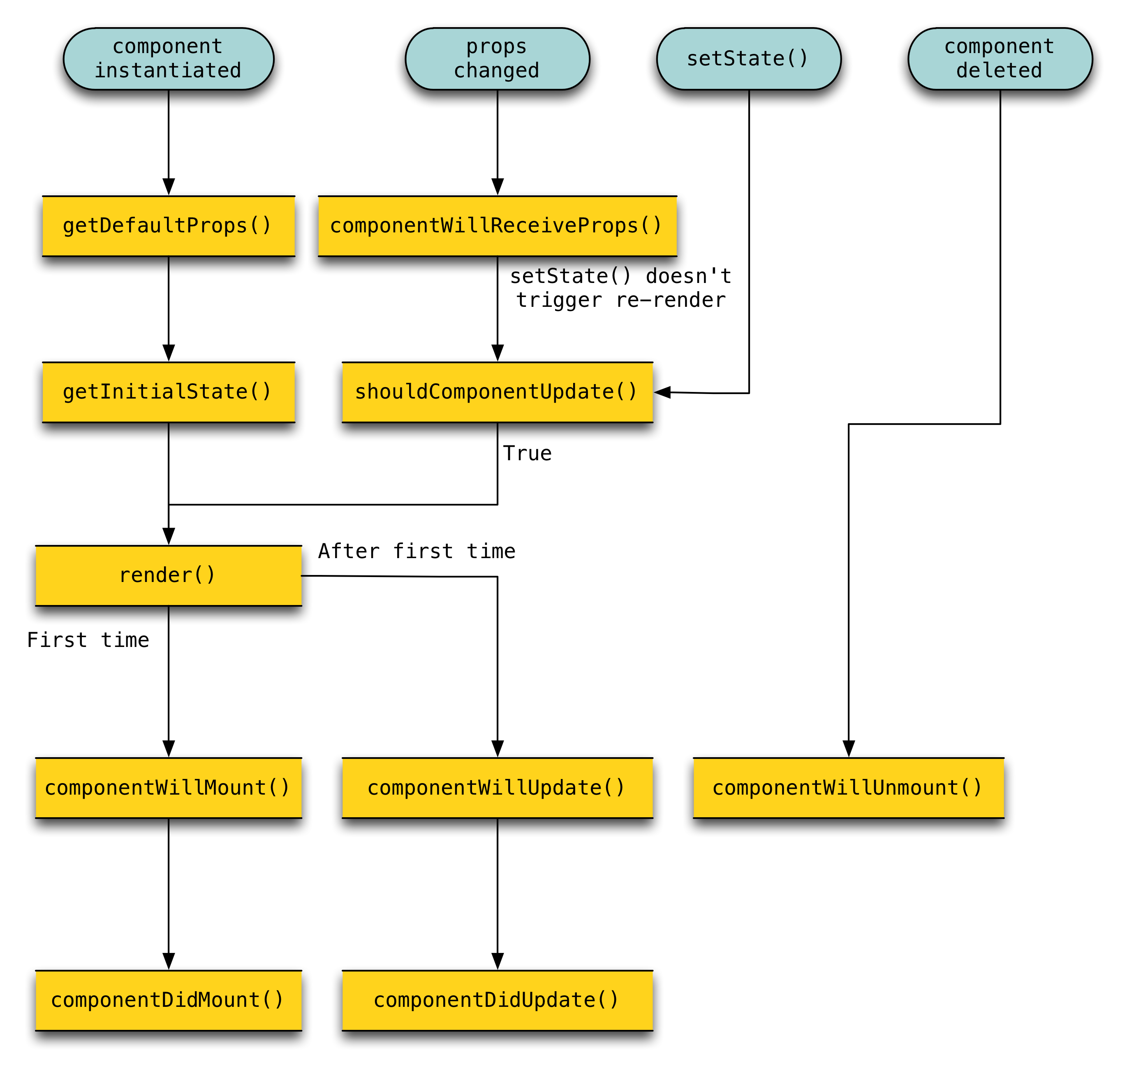
REACT JS
Components Lifecycle

Slide 37
REACT JS
/**
* ------------------ The Life-Cycle of a Composite Component ------------------
*
* - constructor: Initialization of state. The instance is now retained.
* - componentWillMount
* - render
* - [children's constructors]
* - [children's componentWillMount and render]
* - [children's componentDidMount]
* - componentDidMount
*
* Update Phases:
* - componentWillReceiveProps (only called if parent updated)
* - shouldComponentUpdate
* - componentWillUpdate
* - render
* - [children's constructors or receive props phases]
* - componentDidUpdate
*
* - componentWillUnmount
* - [children's componentWillUnmount]
* - [children destroyed]
* - (destroyed): The instance is now blank, released by React and ready for GC.
*
* -----------------------------------------------------------------------------
*/
Composite Components Lifecycle
Notes:
Xong react js
React chỉ chỉ hộ trợ các hàm để render view

Slide 38
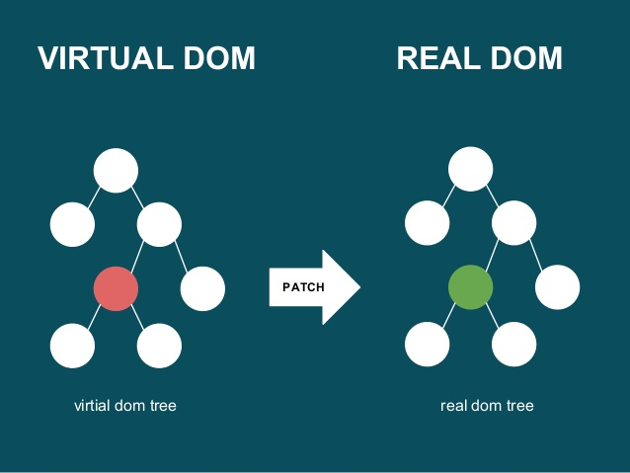
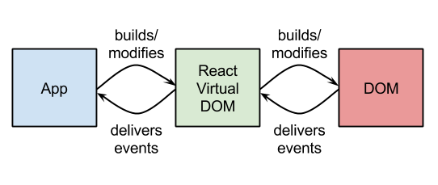
React Router
Virtual DOM

Slide 39
React Router
React Router is a powerful routing library built on top of React that helps you add new screens and flows to your application incredibly quickly, all while keeping the URL in sync with what's being displayed on the page.
path: /inbox/messages/1234
+---------+------------+------------------------+
| About | Inbox | |
+---------+ +------------------------+
| Compose Reply Reply All Archive |
+------------------------------------------------+
|Movie tomorrow| |
+--------------------+ Subject: TPS Report |
|TPS Report From: boss@big.co|
+--------------------+ |
|New Pull Reque | So ... |
+--------------------+ |
|... | |
+--------------+--------------------------------+
path: /inbox
+---------+------------+-------------------------+
| About | Inbox | |
+---------+ +-------------------------+
| Compose Reply Reply All Archive |
+-------------------------------------------------+
|Movie tomorrow| |
+-------------------+ 10 Unread Messages |
|TPS Report | 22 drafts |
+-------------------+ |
|New Pull Reque | |
+-------------------+ |
|... | |
+-------------------+----------------------------+

Slide 40
React Router
A route configuration is basically a set of instructions that tell a router how to try to match the URL and what code to run when it does
render((
<Router history={history}>
<Route path="/" component={App}>
<IndexRoute component={Dashboard} />
<Route path="about" component={About} />
<Route path="inbox" component={Inbox}>
<Route path="/messages/:id" component={Message} />
<Redirect from="messages/:id" to="/messages/:id" />
</Route>
</Route>
</Router>
), document.body)
/
-> <App><Dashboard/><a>
/about
-><App><About/></App>
/inbox
-><App><Inbox/></App>
/inbox/messafe/123
-><App>
<Inbox>
<Message/>
<Inbox>
</App>
Notes:
Tạo một cây component với root là một router và

Slide 41
React Router - Lifecycle
<Route path="/" component={App}>
<IndexRoute component={Home}/>
<Route path="invoices/:invoiceId" component={Invoice}/>
<Route path="accounts/:accountId" component={Account}/>
</Route>
/
Component | Lifecycle Hooks called
App | componentDidMount
Home | componentDidMount
Invoice | N/A
Account | N/A

Slide 42
React Router - Lifecycle
<Route path="/" component={App}>
<IndexRoute component={Home}/>
<Route path="invoices/:invoiceId" component={Invoice}/>
<Route path="accounts/:accountId" component={Account}/>
</Route>
/invoices/123
Component | Lifecycle Hooks called
App | componentWillReceiveProps, componentDidUpdate
Home | componentWillUnmount
Invoice | componentDidMount
Account | N/A

Slide 43
React Router - Lifecycle
<Route path="/" component={App}>
<IndexRoute component={Home}/>
<Route path="invoices/:invoiceId" component={Invoice}/>
<Route path="accounts/:accountId" component={Account}/>
</Route>
/invoices/789
Component | Lifecycle Hooks called
App | componentWillReceiveProps, componentDidUpdate
Home | N/A
Invoice | componentWillReceiveProps, componentDidUpdate
Account | N/A

Slide 44
React Router - Lifecycle
<Route path="/" component={App}>
<IndexRoute component={Home}/>
<Route path="invoices/:invoiceId" component={Invoice}/>
<Route path="accounts/:accountId" component={Account}/>
</Route>
/accounts/123
Component | Lifecycle Hooks called
App | componentWillReceiveProps, componentDidUpdate
Home | N/A
Invoice | componentWillUnmount
Account | componentDidMount

Slide 45
FLUX
Flux is just an architecture, not a framework.
Actions – Helper methods that facilitate passing data to the Dispatcher
Dispatcher – Receives actions and broadcasts payloads to registered callbacks
Stores – Containers for application state & logic that have callbacks registered to the dispatcher
Controller Views – React Components that grab the state from Stores and pass it down via props to child components.

Slide 46
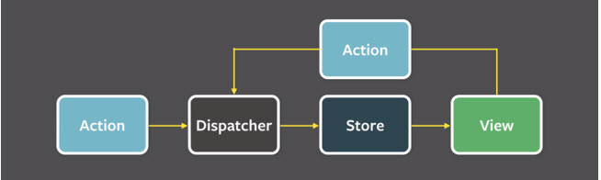
FLUX

Slide 47
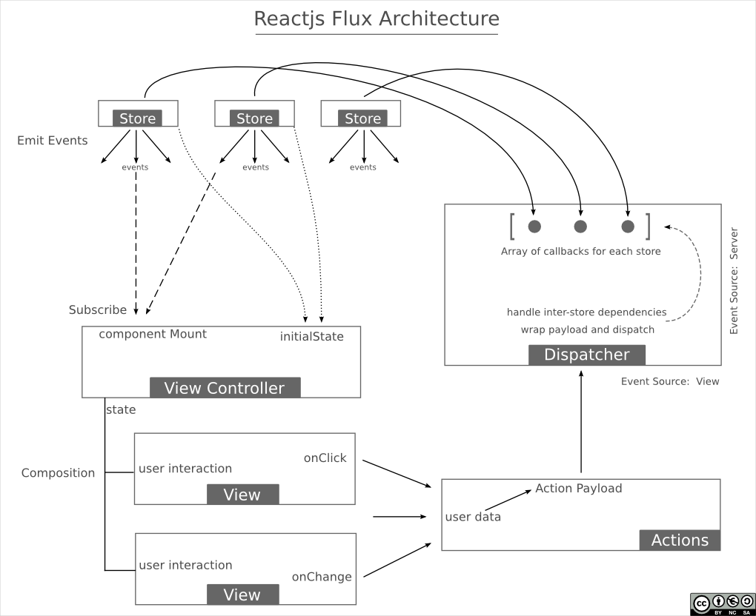
FLUX

Slide 48
FLUX - Dispatcher
The Dispatcher: The Dispatcher is basically the manager of this entire process
var Dispatcher = require('flux').Dispatcher;
var AppDispatcher = new Dispatcher();
AppDispatcher.handleViewAction = function(action) {
this.dispatch({
source: 'VIEW_ACTION',
action: action
});
}
module.exports = AppDispatcher;

Slide 49
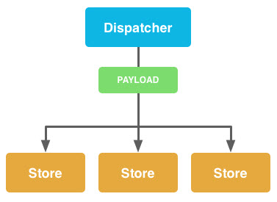
FLUX - Dispatcher
The Dispatcher

Slide 50
FLUX - Stores
Stores: Stores manage application state for a particular domain within your application. From a high level, this basically means that per app section, stores manage the data, data retrieval methods and dispatcher callbacks.

Slide 51
FLUX – Stores
function loadShoes(data) {
_shoes = data.shoes;
}
var ShoeStore = merge(EventEmitter.prototype, {
// Returns all shoes
getShoes: function() {
return _shoes;
},
emitChange: function() {
this.emit('change');
},
addChangeListener: function(callback) {
this.on('change', callback);
},
removeChangeListener: function(callback) {
this.removeListener('change', callback);
}
});

Slide 52
FLUX - Stores
// Register dispatcher callback
AppDispatcher.register(function(payload) {
var action = payload.action;
var text;
// Define what to do for certain actions
switch(action.actionType) {
case ShoeConstants.LOAD_SHOES:
// Call internal method based upon dispatched action
loadShoes(action.data);
break;
default:
return true;
}
// If action was acted upon, emit change event
ShoeStore.emitChange();
return true;
});

Slide 53
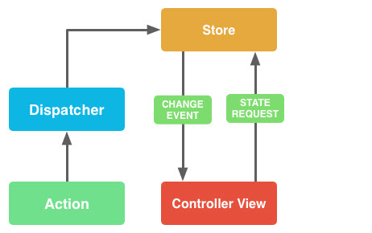
FLUX - Stores

Slide 54
FLUX - Actions
Action Creators are collections of methods that are called within views (or anywhere else for that matter) to send actions to the Dispatcher. Actions are the actual payloads that are delivered via the dispatcher
var ShoeStoreActions = {
loadShoes: function(data) {
AppDispatcher.handleAction({
actionType: ShoeStoreConstants.LOAD_SHOES,
data: data
})
}
};

Slide 55
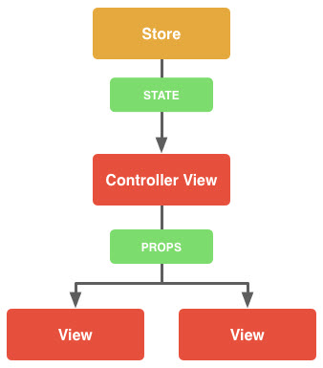
FLUX – Controller View
Controller views are really just React components that listen to change events and retrieve Application state from Stores. They then pass that data down to their child components via props.

Slide 56
FLUX – Controller View
function getAppState() {
return { shoes: ShoeStore.getShoes() };
}
var ShoeStoreApp = React.createClass({
// Use getAppState method to set initial state
getInitialState: function(){ return getAppState(); },
// Listen for changes
componentDidMount: function() { ShoeStore.addChangeListener(this._onChange); },
// Unbind change listener
componentWillUnmount: function() { ShoesStore.removeChangeListener(this._onChange);},
render: function() {
return ( <ShoeStore shoes={this.state.shoes} />);
},
// Update view state when change event is received
_onChange: function() { this.setState(getAppState());}
});

Slide 57
FLUX – Controller View
https://scotch.io/tutorials/getting-to-know-flux-the-react-js-architecture#stores

Slide 58
What makes React different?
Components, not templates
Re-render on update
Virtual DOM (and events)
Reuseable

